Slide 1
C_U Fish ： Rasterization vs. ray tracing in food rendering with blender
Siyu Zhang
11.12

Slide 2
Table of contents
1. Introduction
Goal of “C_U Fish”
2. Software and Technologies
3. Findings
Outputs images and animation
4. Compare and Analyze Outputs
5. Conclusion

Slide 3
Introduction

Slide 4
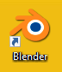
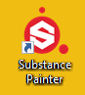
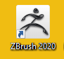
Software & technologies
Blender 2.90: Modeling, minor sculpting, UV Unwrapping, Shading, Lighting and Rendering (images and animation)
ZBrush 2020: Sculpting
Substance Painter: drawing the textures
Output 5 texture maps
Add-on: GoB
Notes:
SP: Output 5 texture maps (Base Color, Height, Meltaness, Normal, Roughness) and connected them with “Principle BSDF” node in Shading mode of Blender

Slide 5
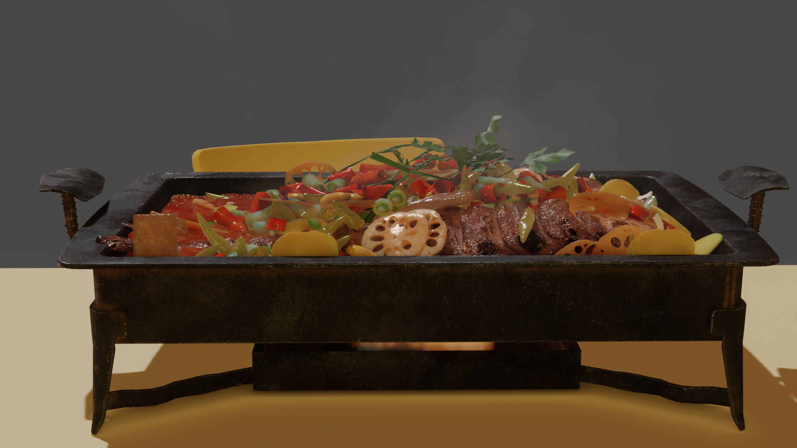
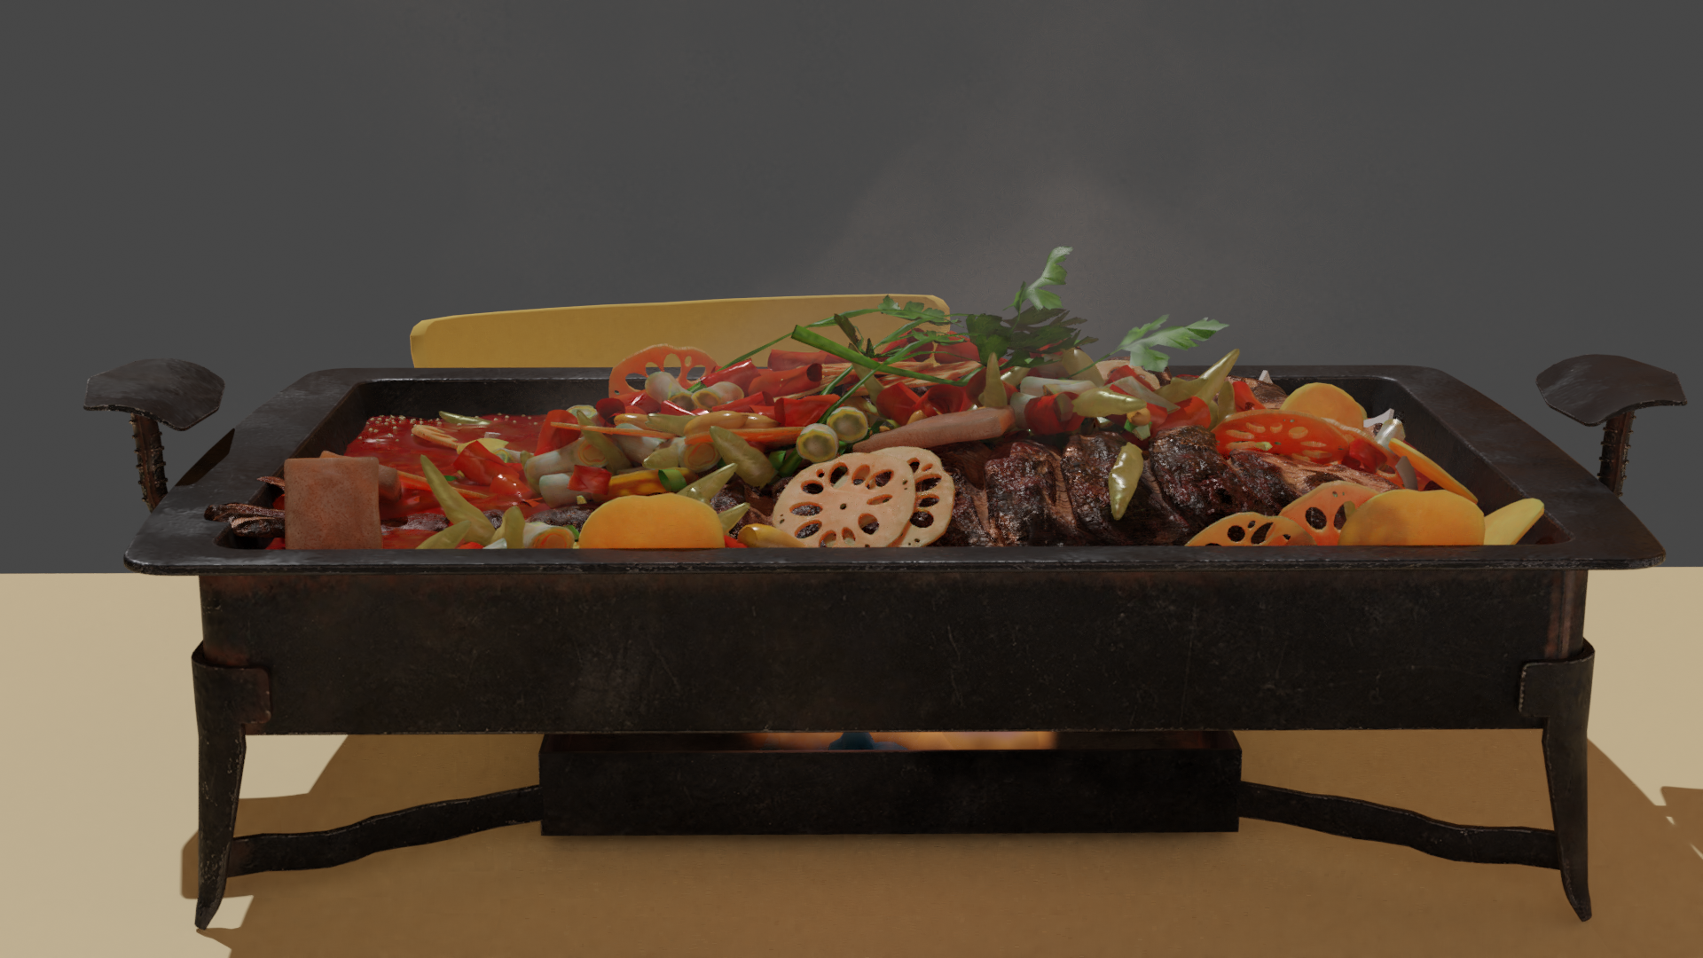
findings
Frame 140 Eevee
Frame 140 Cycles

Slide 6
Compare and Analyze outputs

Slide 7
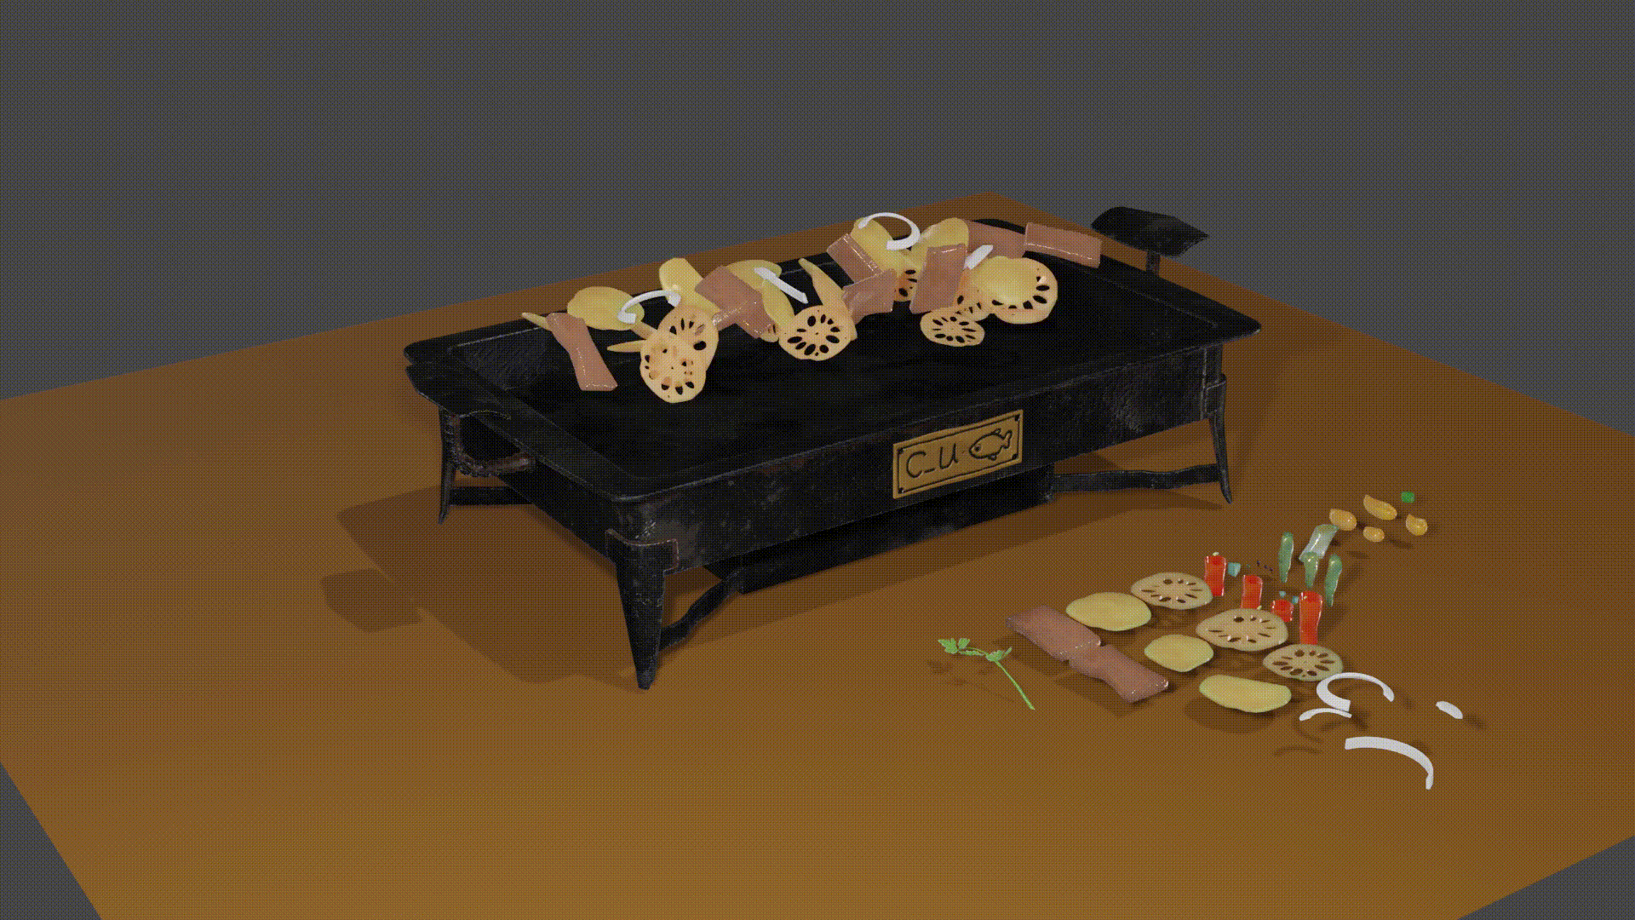
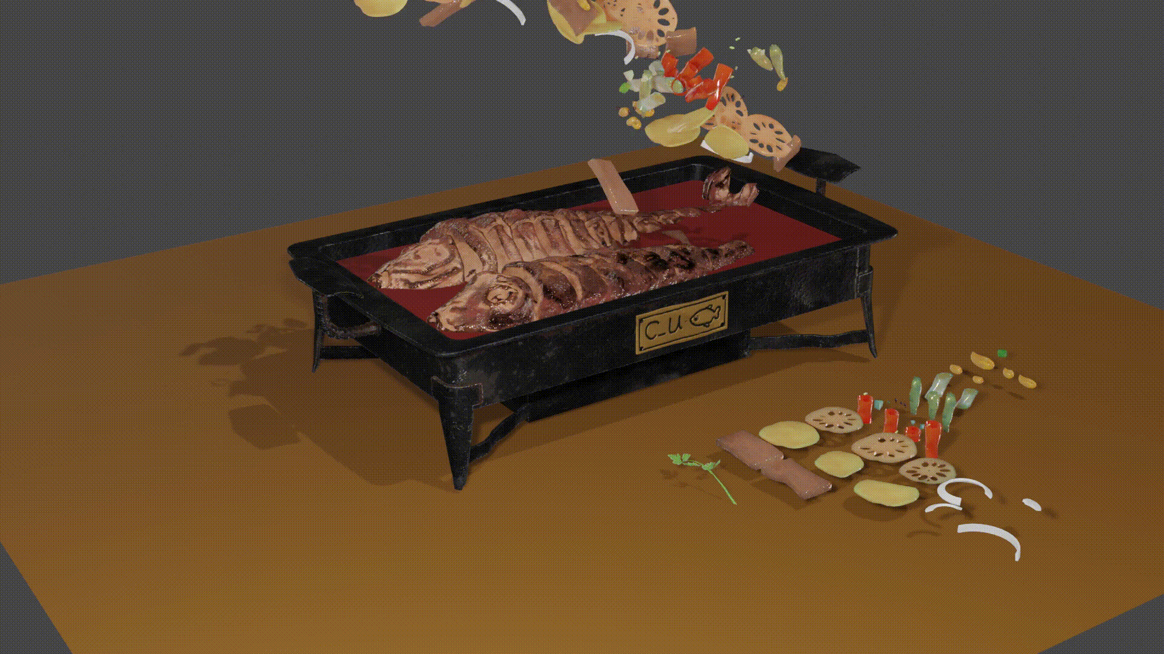
cONCLUSION
Added the vegetables to the plate
First Layer Second Layer

Slide 8
references
GitHub Page: https://github.com/CU2018/C_U-Fish-Blender
Add-ons:
GoB: https://archive.blender.org/wiki/index.php/Extensions:2.6/Py/Scripts/Import-Export/GoB_ZBrush_import_export/

Slide 9
THANKS FOR LISTENING~
QUESTIONS?

